Slide 1

Stop Phishing Scam Email
Mercy Hong
18096

Slide 2
What is Phishing Scam Email?
Phishing is a type of cyber attack where the attacker uses fraudulent emails or websites to steal personal information such as passwords, credit card numbers, and bank account information. The emails are designed to look like they come from a legitimate source and often contain links or attachments that, when clicked, can install malicious software on the user’s device. The goal of the attacker is to get the user to provide their personal information, which can then be used for financial gain.

Slide 3

Issue of Phishing Scam Email
The issue of phishing scam emails is an increasingly prominent one. Phishing scams involve malicious emails that are designed to look like they come from a legitimate source, such as a bank or a business, in order to extract personal or financial information from the recipient. These emails often contain links or attachments that, if clicked, can install malware and other malicious code on the user’s device. As such, it is important to be vigilant against such emails and to be aware of the various tactics used by scammers to entice users to click on links. This includes looking out for suspicious email addresses, typos in the body of the email, and any request for personal information. Additionally, users should be aware of the potential for malicious links to be sent via social media, text messages, and other messaging services.

Slide 4
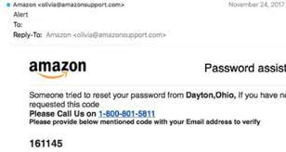

Example of Phishing Scam Email

Slide 5
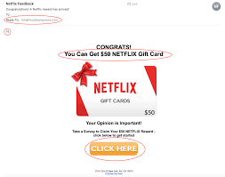
Example of Phishing Scam Email

Slide 6
Idea Solution for Identified Phishing Scam Email Issue
1. Educate users on how to recognize phishing emails and the dangers of clicking on suspicious links.
2. Implement a two-factor authentication system to protect user accounts.
3. Use email filtering software to detect and block malicious emails.
4. Develop a user-friendly policy for reporting suspicious emails.
5. Monitor user accounts for suspicious activity and take action when needed.

Slide 7
Evidence of Phishing Scam Email Issue
1. Gather examples of actual phishing emails received by users.
2. Track the number of successful phishing attempts over time.
3. Collect survey data from users on their level of awareness about phishing scams.
4. Analyze logs of user activity to identify any suspicious behavior.
5. Monitor the security of user accounts and devices for any signs of malicious activity.

Slide 8

Solution to Avoid Phishing Scam Email
1. Be wary of any emails that contain urgent or threatening language.
2. Pay close attention to the URL of a website you visit. A legitimate website address should begin with “https”.
3. Never respond to emails or open attachments from unknown sources.
4. Use two-factor authentication whenever possible.
5. Be suspicious of any emails that ask for personal information such as passwords or bank account information.

Slide 9

How to Avoid Getting Phishing Scam Email
1. Suspicious email addresses.
2. Typos in the body of the email.
3. Requests for personal information.
4. Links sent via social media, text messages, and other messaging services.
5. Malicious attachments that can install malware on the user’s device.

Slide 10

Thank You!
Question and Answer.

